Slide 1
Economic & Real Estate Outlook
Lawrence Yun, Ph.D.
Chief Economist, National Association of REALTORS®
Presentation at New Orleans Real Estate Forecast Symposium
New Orleans, LA
October 10, 2017

Slide 2
GDP Quarterly Growth Rate

Slide 3
Presidential GDP Growth Rates

Slide 4
Personal Consumption Growth Rate

Slide 5
Business Spending Growth Rate (Non-residential fixed investment)

Slide 6
Business Investment Spending Spending for Structure lagging behind Equipment ($ billion)

Slide 7
Government Spending Growth Rate

Slide 8
Export and Import Growth Rates
Exports (Red)
Imports (Blue)

Slide 9
Exports and Imports

Slide 10
Unemployment Rate vs. Employment Rate

Slide 11
Employment Rate: Men vs Women

Slide 12
Total Job Openings
In thousands

Slide 13
Weekly Initial Unemployment Insurance Filings
In thousands

Slide 14
Mortgage Rates Taper Tantrum and Trump Election 30-year Fixed Rate

Slide 15
Stock Market: S&P 500 Index

Slide 16
Animal Spirit Revival of Consumers? Consumer Confidence Index

Slide 17
Animal Spirit Revival of Businesses? Small Business Optimism Index

Slide 18
New Supply
Homebuilding
Single-family rentals are sold (not bought)
Airbnb ... Fewer vacant homes and rooms

Slide 19
Single-family Housing Starts (Shortage of Lots, Labor, Lending, Lumber)
Thousand units

Slide 20
Months to Sell a Newly Built Home

Slide 21
Multifamily Housing Starts
Thousand units

Slide 22
Steady Job Creations (8 million lost … 16 million gained)
In thousands

Slide 23
Total Jobs in New Orleans Metro
In thousands

Slide 24
Total Job Openings
In thousands

Slide 25
Homeowners Equity in Real Estate from 1990
$ billion

Slide 26
CPI Inflation: No Worries (Overall and Core)

Slide 27
Monetary Policy Fed Funds Rate

Slide 28
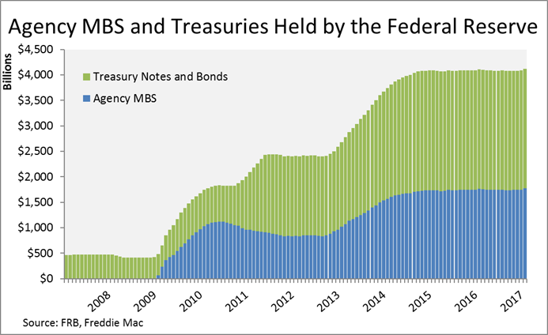
Federal Reserve Balance Sheet Pace and Impact of Unwinding? Slow but Uncertain

Slide 29
Apartment
%
Source: CBRE via ULI

Slide 30
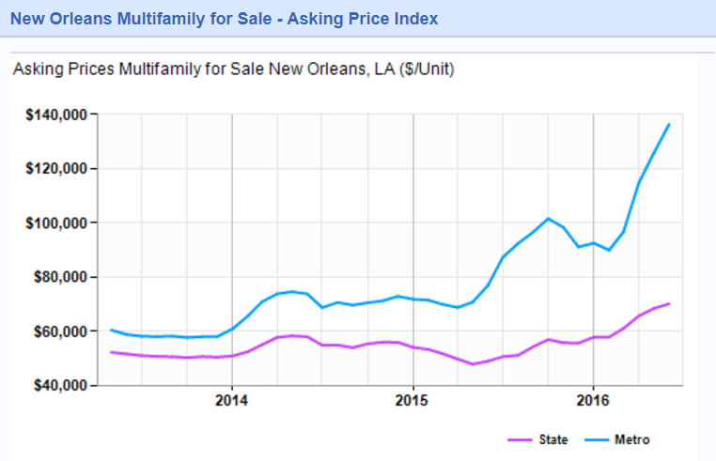
New Orleans Market Pricing for multifamily properties accelerates in 2017
Source: Louisiana Commercial Realty, LoopNet

Slide 31
New Orleans Metro Housing Permits Single-Family and Multifamily

Slide 32
Pent-Up Demand: Actual vs Projected Households KC Federal Reserve estimate of 6.9 million missing households

Slide 33
Young Adults Living with Parents % of those aged 25 to 34

Slide 34
Post-College Likely Renters (Age 25 to 29)

Slide 35
Office
%
Source: CBRE via ULI

Slide 36
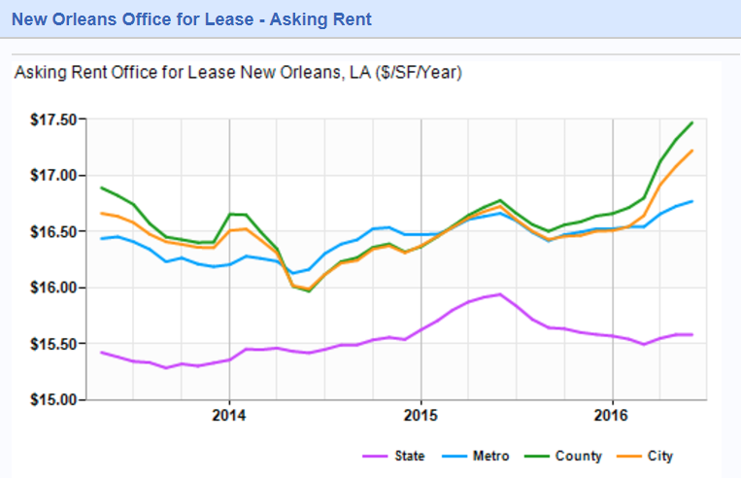
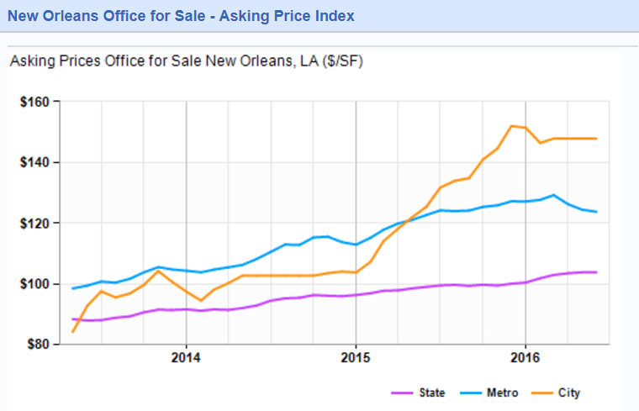
New Orleans Market Office rents pick up, while investment prices flatten
Source: Louisiana Commercial Realty, LoopNet
Source: Louisiana Commercial Realty, LoopNet

Slide 37
Industrial-Warehouse
%
Source: CBRE via ULI

Slide 38
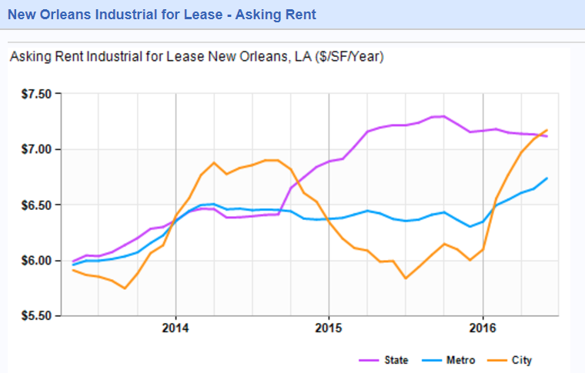
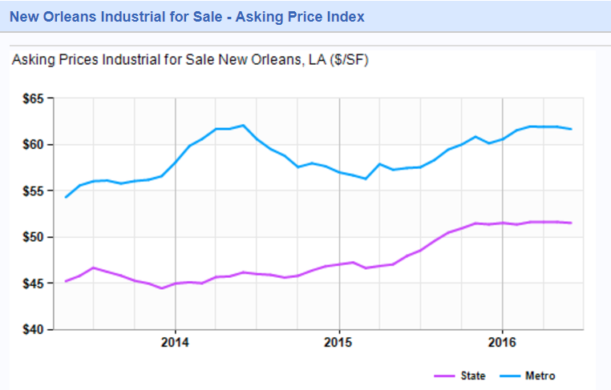
New Orleans Market Industrial demand drives rent growth
Source: Louisiana Commercial Realty, LoopNet
Source: Louisiana Commercial Realty, LoopNet

Slide 39
Retail
%
Source: CBRE via ULI

Slide 40
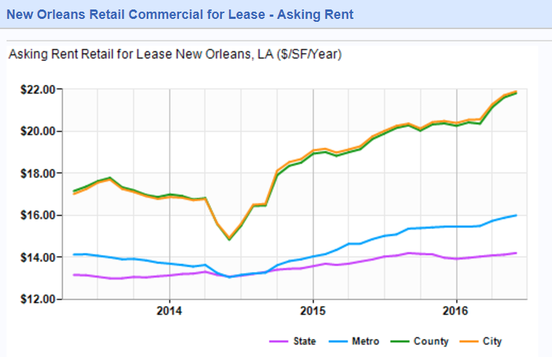
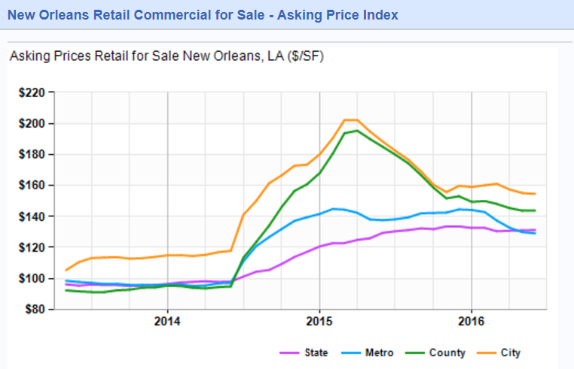
New Orleans Market Retail rents reflect gains in tourism flows
Source: Louisiana Commercial Realty, LoopNet
Source: Louisiana Commercial Realty, LoopNet

Slide 41
Why Industrial Outperforms?

Slide 42
Past Non-Store Retail Sales

Slide 43
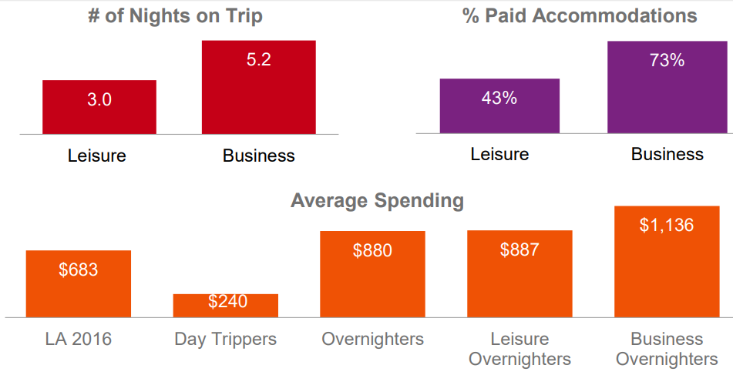
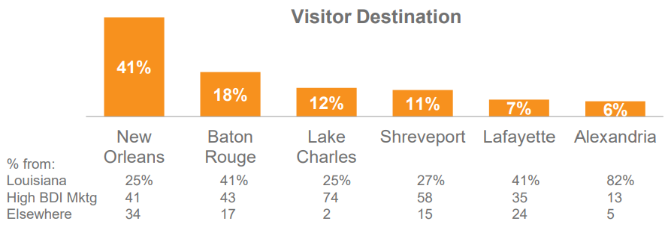
New Orleans remains dominant travel destination in LA…
Source: Kantar TNS
Source: Kantar TNS

Slide 44
Commercial Property Price may be Bubblish (90% gain in 7 years)
Source: Federal Reserve

Slide 45
Commercial Investment Sales of Large Properties (Properties valued at $2.5 million and over)

Slide 46
NCREIF Cap Rates – Likely Already Hit Cyclical Low
%

Slide 47
New Orleans CRE investments mirror broader US trends
Q2.2017: 6.4%
Source: Real Capital Analytics
Source: Real Capital Analytics

Slide 48
REALTORS® CRE sales rebound 4.4% in Q2.2017

Slide 49
Big Cap and Small Cap
Real Capital Analytics
$2.5 million and over transactions
REALTOR Activity
Mostly around $500,000 to $1 million transactions

Slide 50
Forecast

Slide 51
Economic Forecast
 | 2015 | 2016 | 2017 Forecast | 2018 Forecast
GDP Growth | 2.9% | 1.5% | 1.7% | 2.7%
Job Growth | +2.6 million | +2.0 million | +1.8 million | +2.4 million
CPI Inflation | 0.3% | 1.3% | 2.0% | 2.5%

Slide 52
Actual versus projected Households KC Federal Reserve estimate of 6.9 million missing households

Slide 53
Young Adults Living with Parents % of those aged 25 to 34

Slide 54
Housing Forecast
 | 2015 | 2016 | 2017 Forecast | 2018 Forecast
New Home Sales | 500,000 | 560,000 | 600,000 | 700,000
Existing Home Sales | 5.3 million | 5.4 million | Fewer | 5.8 million
Median Price Growth | + 6.8% | +5.1% | +5.7% | +4.6%
30-year Rate | 3.9% | 3.6% | 4.0% | 4.5%

Slide 55
Commercial Real Estate Forecast 2017-2018
 | Vacancy | Rent
Apartment | Rising 50 to 80 basis points | Rising Slowly 3% per year
Office | Stable | 2.5% per year
Industrial | Stable | 4% per year
Retail | Stable | 2% per year

Slide 56
Rising Cap Rates and Commercial Real Estate Prices
Steady prices in mid-tier markets
Modest price correction in big cities and trophy properties
Green Street price index could fall 4% to 8% over the next two years

Slide 57
Trump Presidency
Dodd-Frank?
Fannie/Freddie and Mortgage Availability?
Tax Simplification? and Mortgage Interest Deduction and 1031 exchange?
EPA, land use, development fees?

